Slide 1

Space Syntax Toolkit for QGIS Introduction and recent developments
Abhimanyu Acharya
Associate, Space Syntax Ltd.
Ioanna Kolovou
Senior consultant, Space Syntax Ltd.
Space Syntax Laboratory - UCL
Space Syntax Limited
Workshop 8
Space syntax and analytical design workshops
MSc, MRes Space Syntax: Architecture and Cities
UCL

Slide 2
Demo Workflow
Axial Map Verification
RCL Topology Cleaning
Unlinks Verification
Processing algorithm: simplify geometries
Space Syntax Analysis
Catchment Analyser
Visualisation
Gate Transformer/movement correlation
Urban data input
Integrated Urban Model

Slide 3
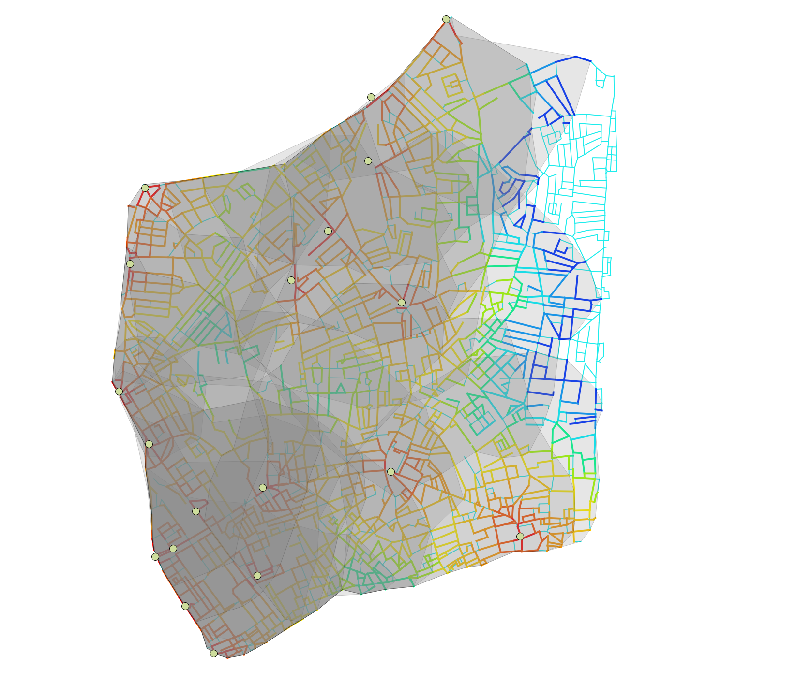
Catchment Analyser
This plugin takes a line-based network and point-based origin layer and calculated the distance from each segment within a given distance or list of distances to each of the origins. The tool outputs the catchment as lines and as a concave hull polygon layer. Credit for the concave hull functionality goes to the algorithm described by Adriano Moreira and Maribel Yasmina Santos.

Slide 4
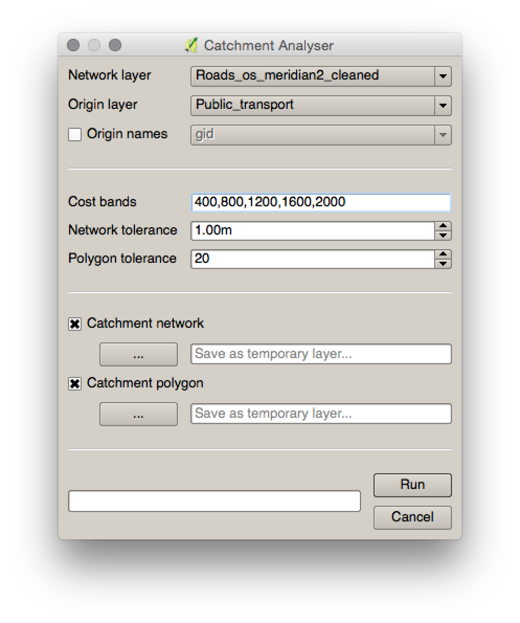
Catchment Analyser
Network layer Choose the line-based vector layer that comprises a topological network you want to analyse. (projected CRS only!!)
Origin layer Choose the point-based vector layer containing the origins from which catchment will be calculated.
Origin Names By default the origin names will be based on the feature ids. If checked the tool will run the catchment analysis based on the column selected.
Cost Bands This sets the radius for the catchment analysis. For example, 400,800,1200,2000.
Network tolerance This is a tolerance for disconnected network. For example, it will connect lines that are within 1m by default.
Polygon tolerance The Catchment Analyser tool creates concave hull polygons from a specific origin. The polygon tolerance defines the level of 'concaveness' of the catchment. The lower the value, the more concave and the higher the value the more convex.
Catchment network The tool provides a catchment network output based on the original network layer with cost information on every origin. If checked the tool will generate the network as a temporary layer or as a shapefile using the browse button.
Catchment polygon The tool provides a catchment polygon output for each origin and each specified cost. If checked the tool will generate the polygons as a temporary layer or as a shapefile using the browse button.

Slide 5
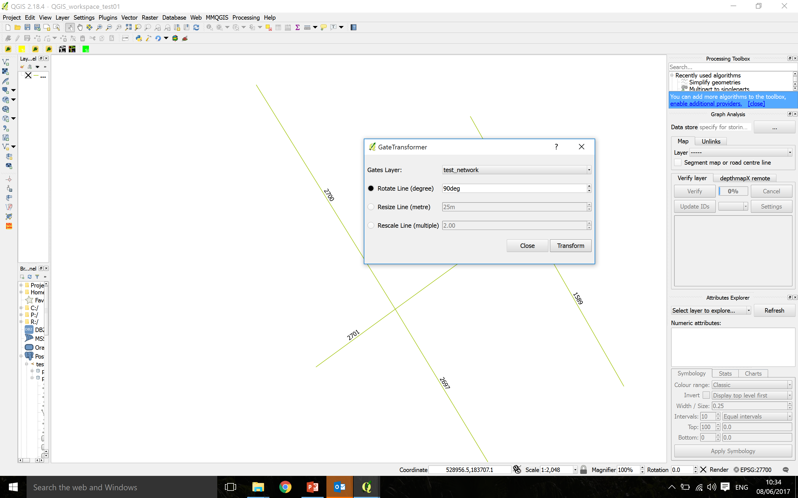
Gate Transformer
Gate Transformer is a plugin to modify the geometry of gates used in space syntax movement observations. Gates are usually drawn perpendicular to the axial line, with varying lengths. For presentation of movement observations the typical output is a map showing lines along the axial lines to indicate the movement direction. The gates should all be rotated 90degrees and have the same length.

Slide 6
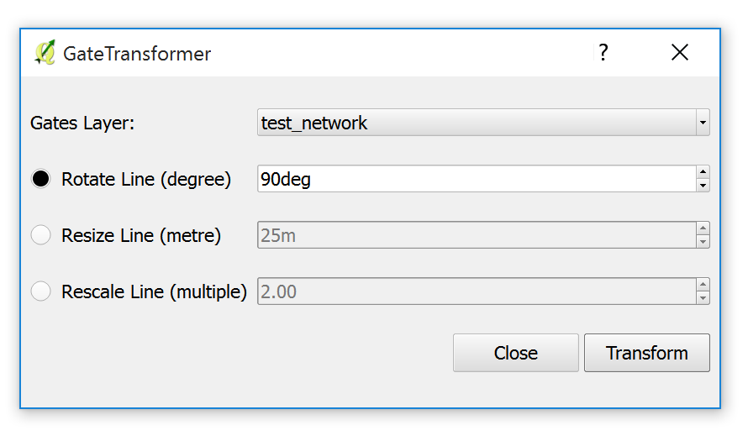

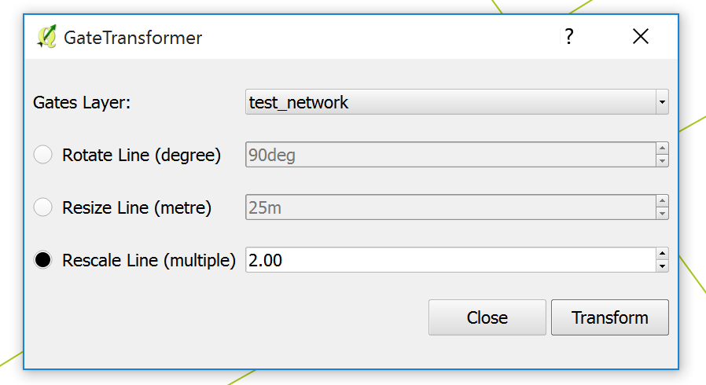
Gate Transformer
Gates layer Choose the line-based gate layer from the drop-down menu that you want to transform
Rotate Line (degree) Define the angle in degrees for rotating the selected gates
Resize Line (metre) Define the length in metres for resizing the selected gates
Rescale Line (multiple) Define the multiple in ratio for rescaling the selected gates
Transform Pressing the transform button will activate the analysis for the selected transformation
Close Pressing close will close and terminate the Gate Transformer
Rotate Line
Resize Line
Rescale Line

Slide 7
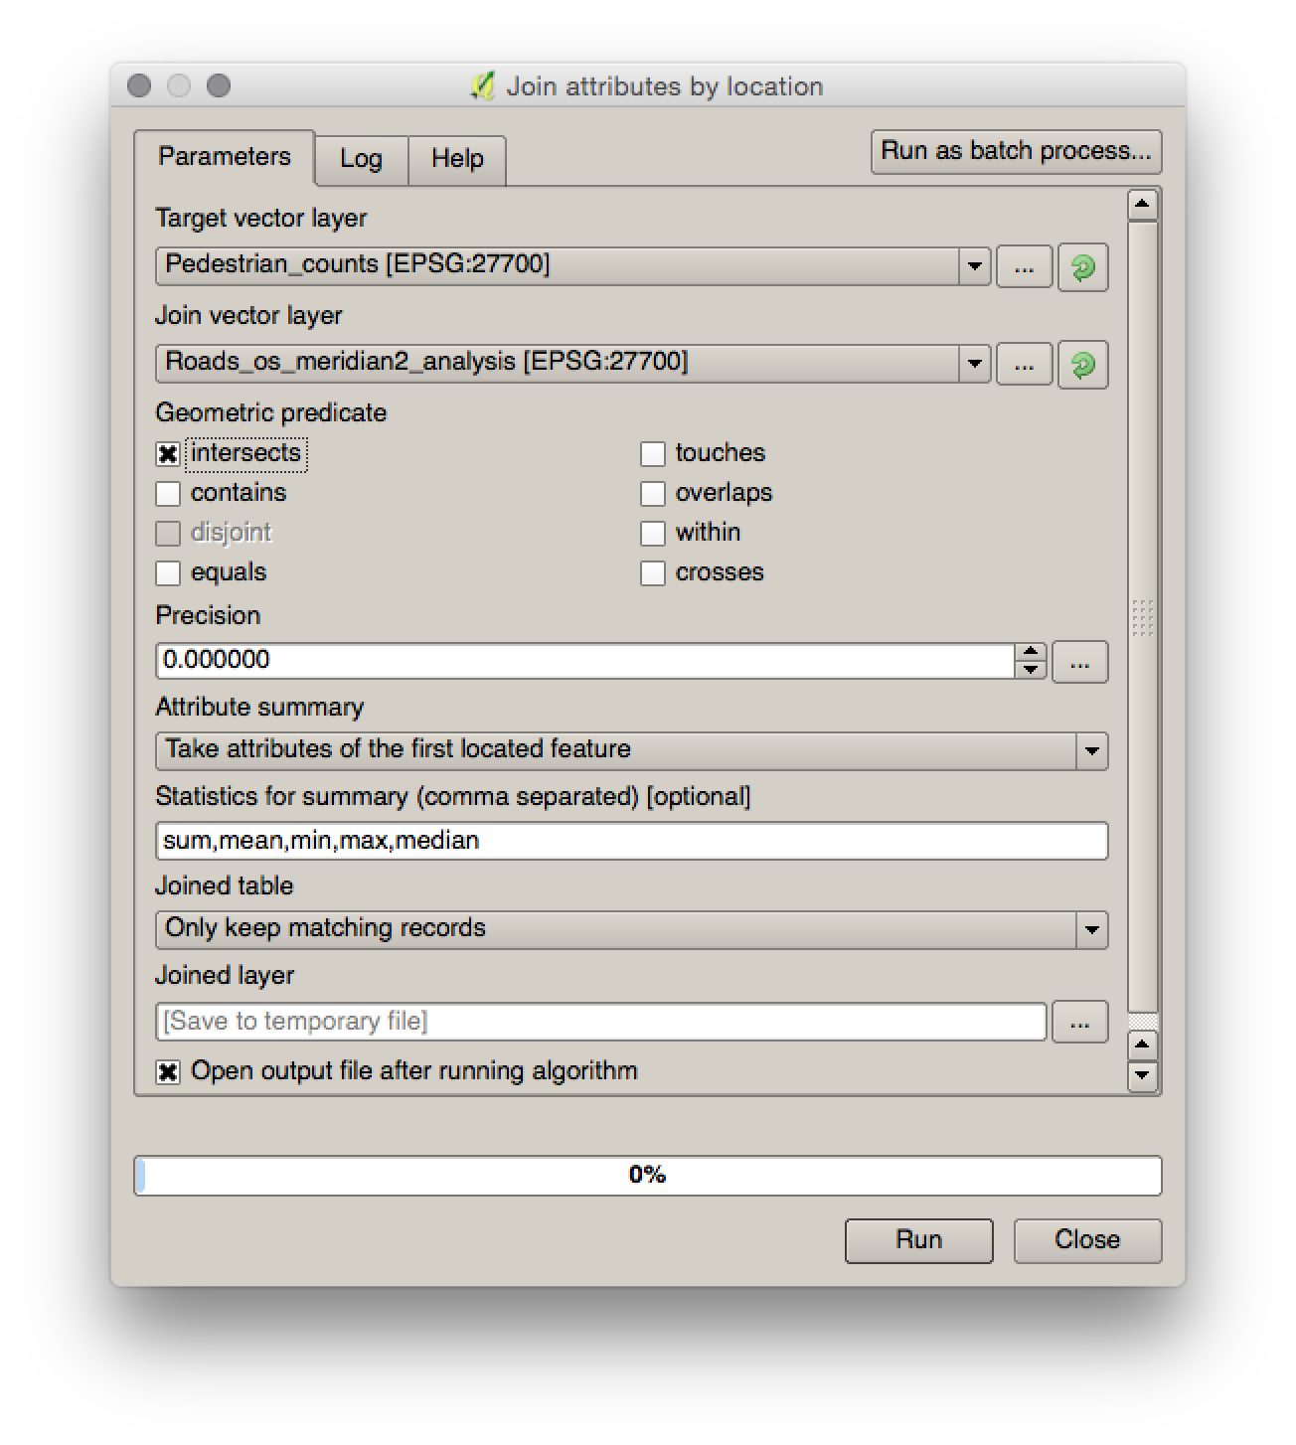
Connecting layers by spatial join
Use the ‘Join attributes by location’ from the processing toolbox

Slide 8
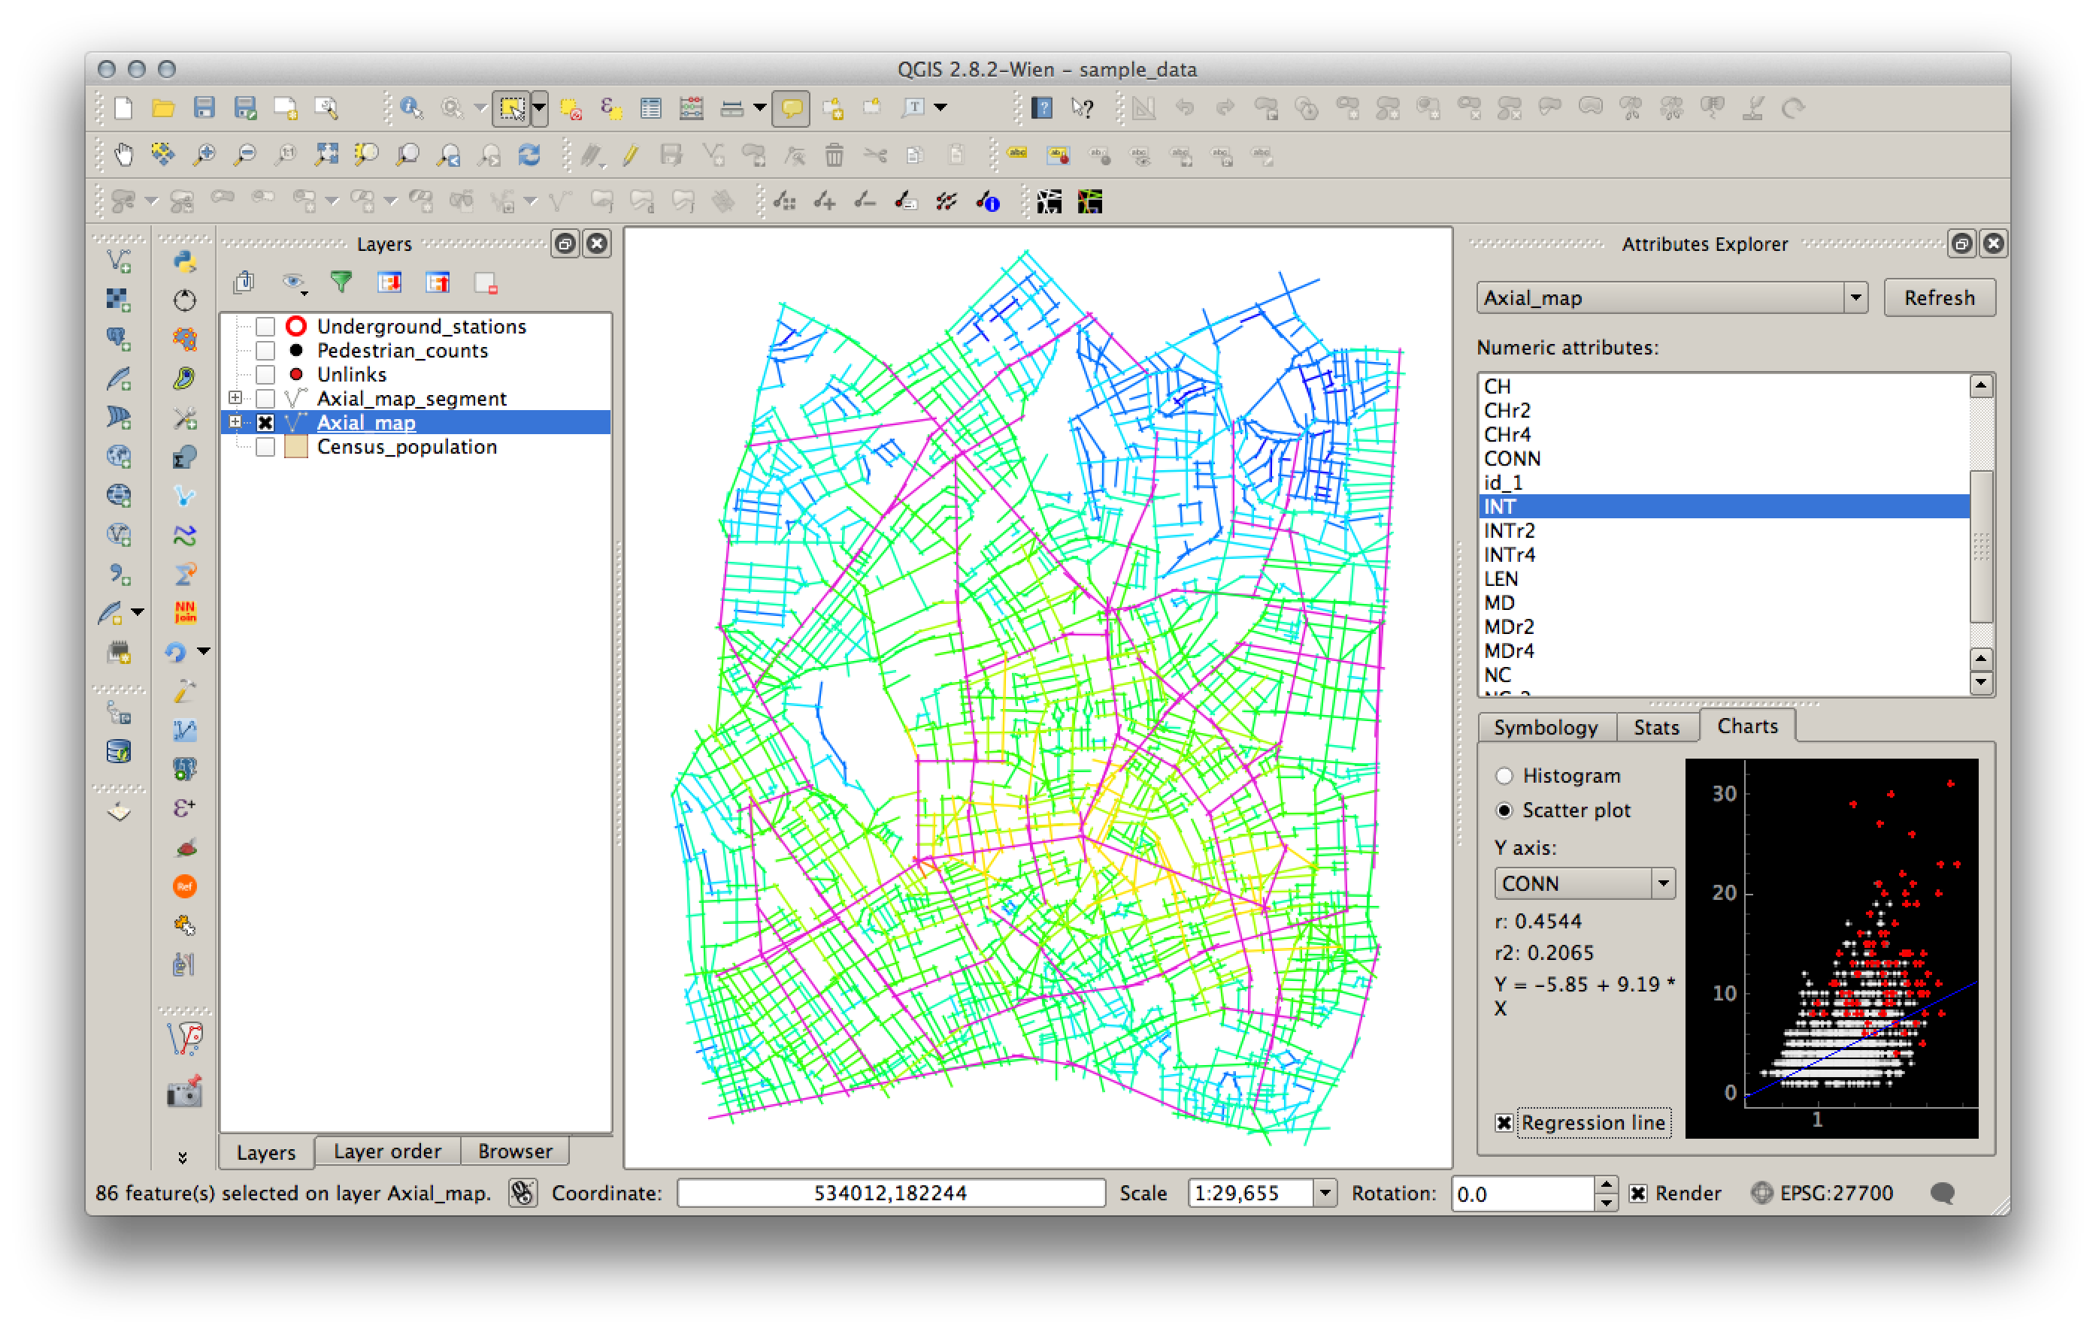
Statistical analysis of two variables

Slide 9
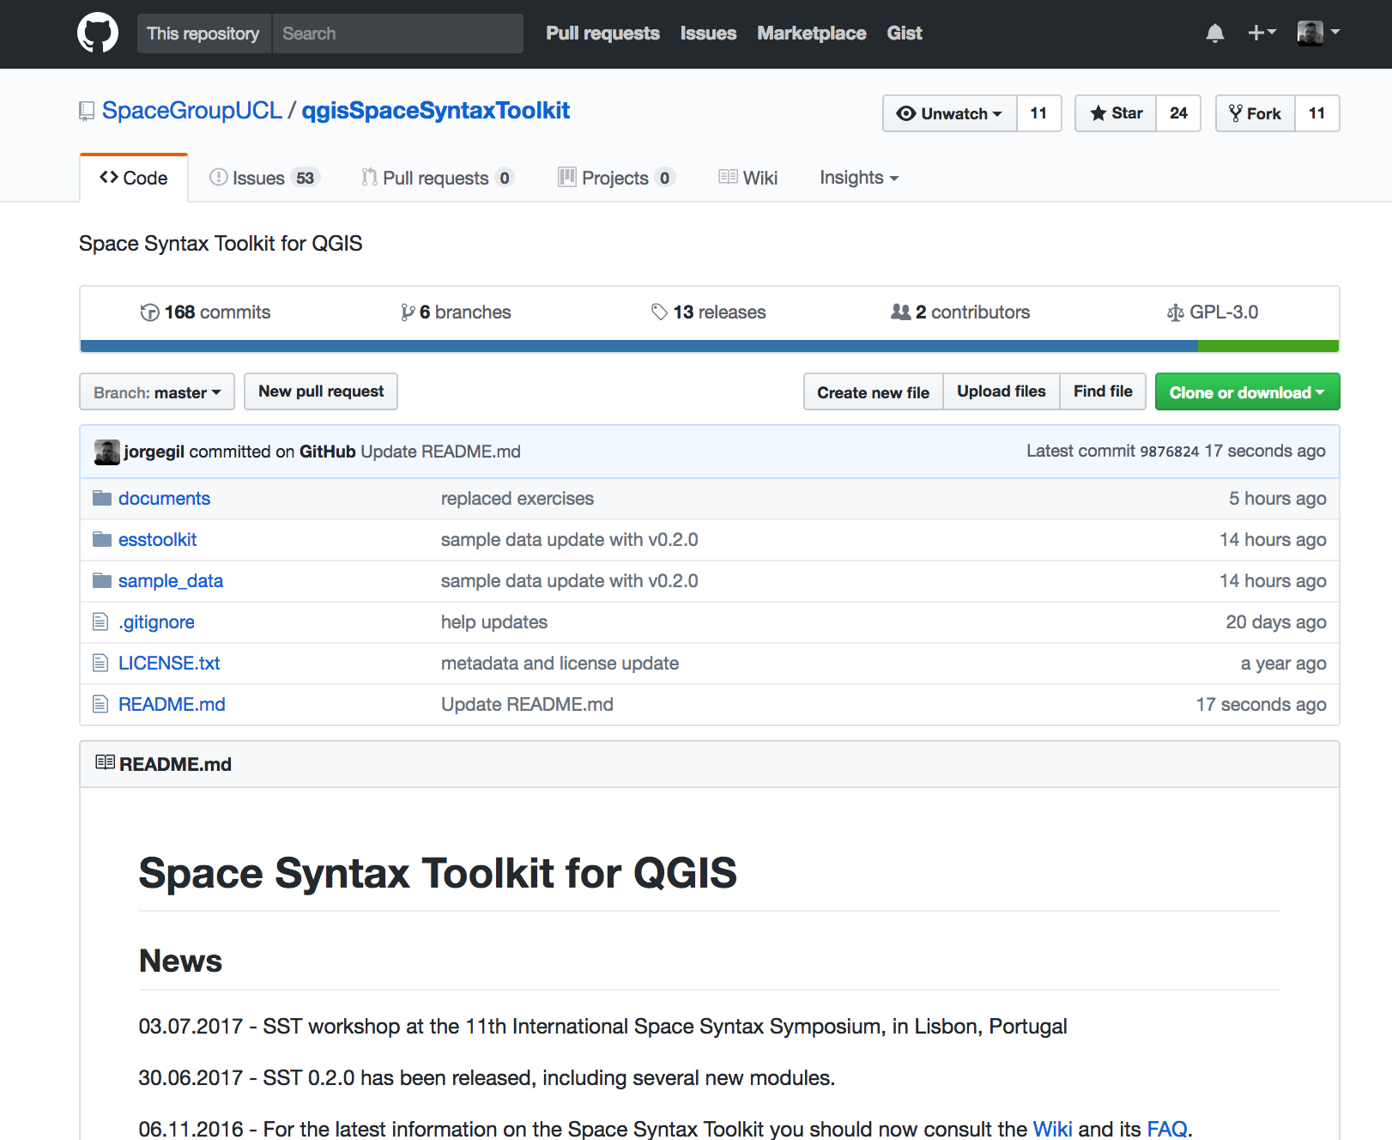
SST Github repository
https://github.com/SpaceGroupUCL/qgisSpaceSyntaxToolkit

Slide 10
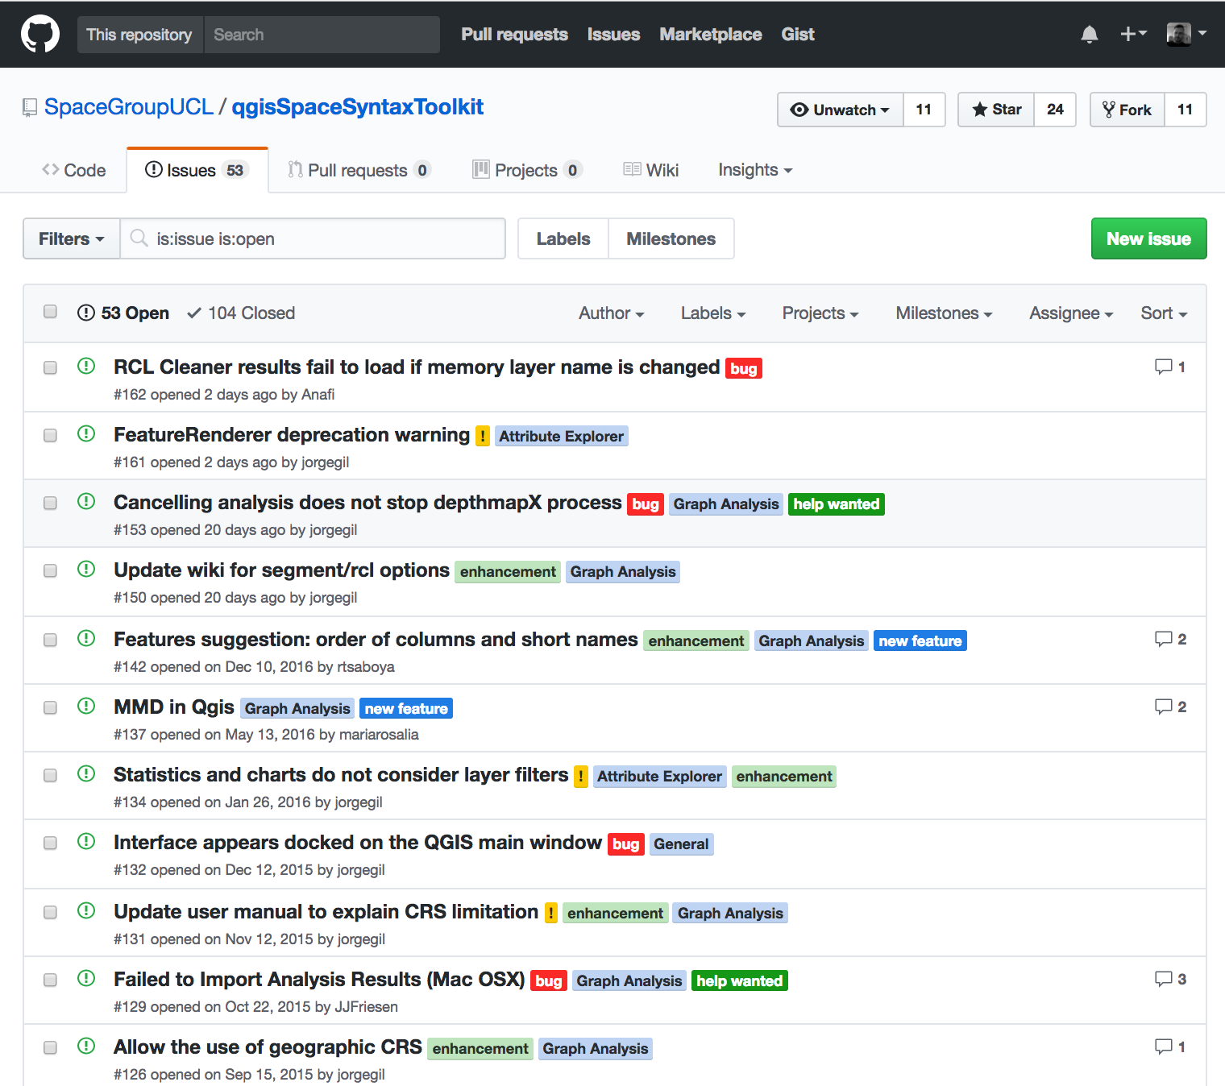
SST Issues
https://github.com/SpaceGroupUCL/qgisSpaceSyntaxToolkit/issues

Slide 11
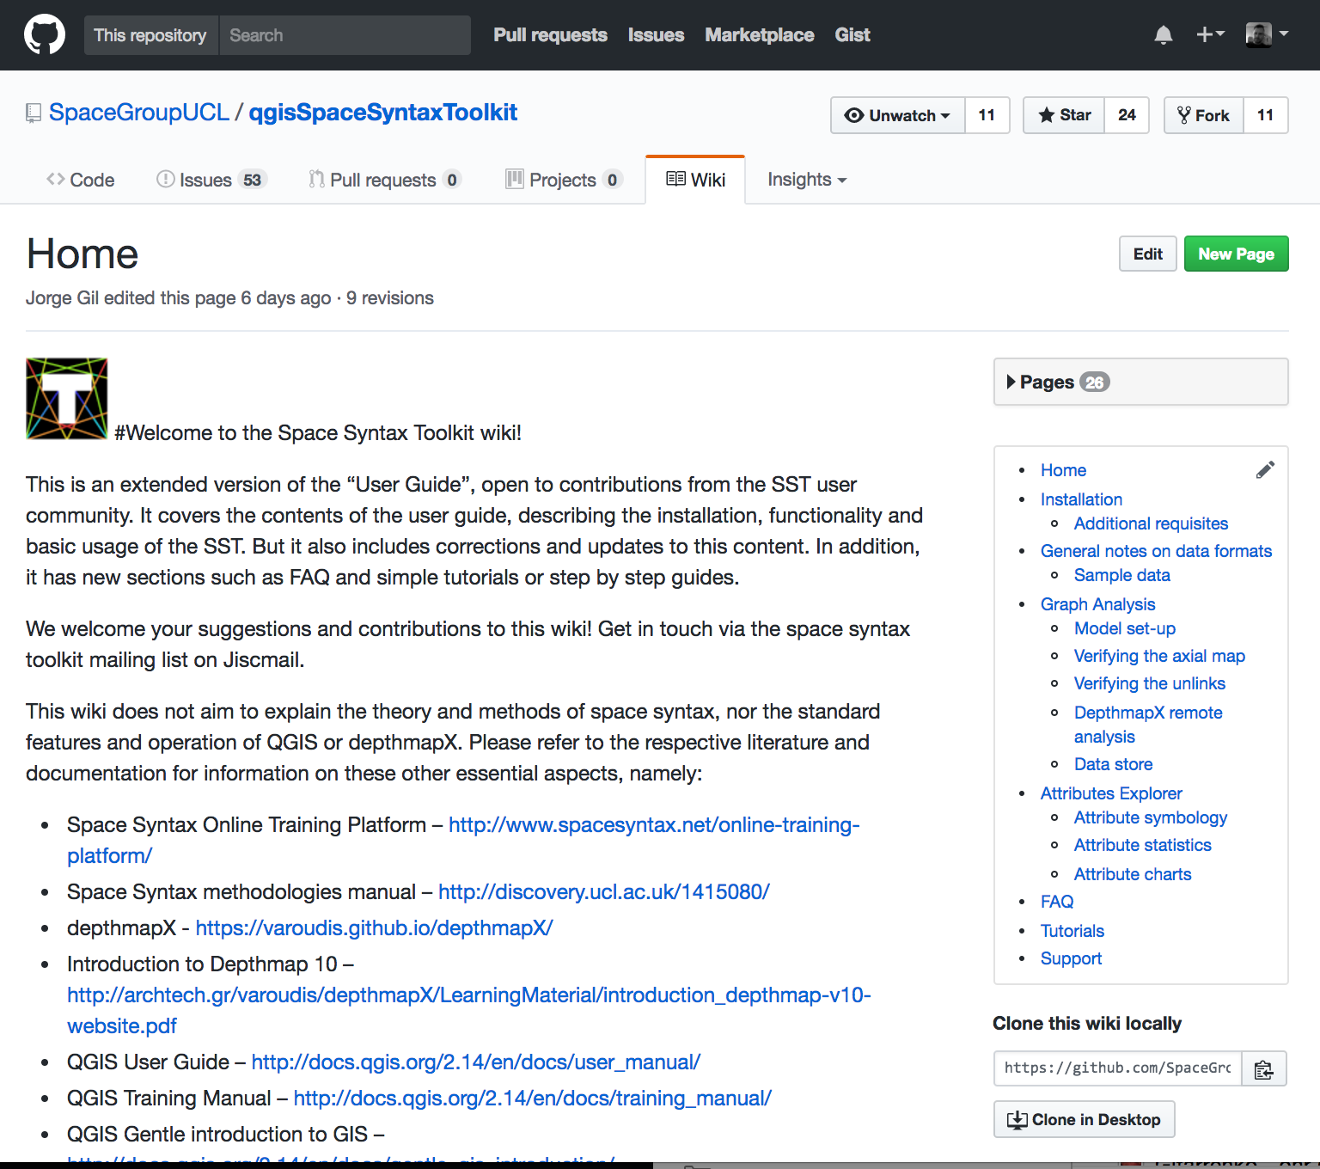
SST Wiki
https://github.com/SpaceGroupUCL/qgisSpaceSyntaxToolkit/wiki

Slide 12
Thank you!
SST mailing list:
https://www.jiscmail.ac.uk/cgi-bin/webadmin?A0=SPACESYNTAX-TOOLKIT
Space syntax mailing list:
https://www.jiscmail.ac.uk/cgi-bin/webadmin?A0=SPACESYNTAX

